Slide 1


The SQL Server 2022 Workshop
Microsoft Azure Data
#sqlserver2022
#azuresql

Slide 2
Goals for this workshop
Learn in an interactive style what is new in SQL Server 2022
Evaluate why you should upgrade to SQL Server 2022
Learn how specific key features work in SQL Server 2022
Gain hands-on experience trying out new features
Walk away with resources you can use to learn more

Slide 3

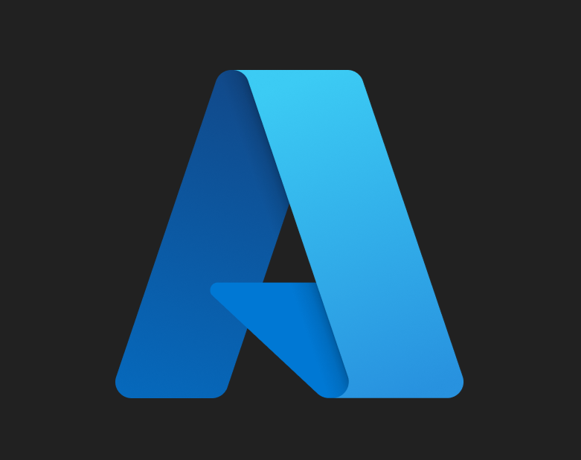
The SQL Server 2022 workshop
Module 1 Introduction to SQL Server 2022
Module 5
Access new sources with data virtualization
and object storage
Module 2 Connect SQL Server 2022 to Azure
Module 6
Enhance your application with new
T-SQL capabilities
Module 3 Accelerate performance with built-in query intelligence
Module 7
Summary and closing
Module 4
Power your database with
security, scalability, and availability
aka.ms/sql2022workshop
aka.ms/sqlserver2022decks
aka.ms/sqlserver2022series
aka.ms/sqlserver2022demos

Slide 4
Introduction to SQL Server 2022
Module 1
Overview of SQL Server 2022
Getting started with SQL Server 2022
Knowledge checks and summary

Slide 5

Introducing SQL Server 2022
Notes:
Editions, licensing, and pricing come at GA

Slide 6
The next step for SQL Server
SQL Server 2016
Query Store
Polybase
Always encrypted
Row level security
It just runs faster
Std Edition surface area
SQL Server 2017
SQL Server on Linux
Containers
Adaptive query processing
Automatic Tuning
Graph database
Machine learning services
SQL Server 2019
Data virtualization
Intelligent query processing
Accelerated database recovery
Data classification

Slide 7








Microsoft SQL – all edges and clouds
Intelligent edge
Intelligent cloud
Develop once deploy anywhere
Azure SQL Edge
SQL Server 2022
SQL on Linux, containers, k8s
Azure Arc-enabled SQL Server
Azure Arc-enabled SQL managed instance
SQL Server on Virtual Machines
Azure SQL managed instance
Azure SQL database
Language
Tools
Engine
Machine Learning
Data Virtualization
Notes:
2 mins

Slide 8






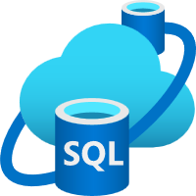

SQL Server 2022 Azure-enabled with continued performance and security innovation
Business continuity through Azure
Seamless analytics over on-prem operational data
Visibility over your entire data estate
Most secure over the last 10 years¹
Industry-leading performance and availability
Microsoft Purview
+
Insights
Lineage
#1 OLTP performance²
#1 Non-Clustered DW performance on 1TB³, 3TB⁴, 10TB⁵, 30TB⁶, and 100TB⁷
Policies
Hero capabilities
Link feature for Managed Instance
Azure Synapse Link
Microsoft Purview integration
Ledger for SQL Server
Built-in query intelligence
Most consistent data platform
Edge to Cloud
Azure SQL Edge
Azure Arc-enabled data services
Azure SQL
All TPC Claims as of 11/10/2022.
¹National Institute of Standards and Technology Comprehensive Vulnerability Database ² http://www.tpc.org/4087; ³ http://www.tpc.org/3386; ⁴ http://www.tpc.org/3385; ⁵ https://tpc.org/3383; ⁶ http://www.tpc.org/3364; ⁷ https://tpc.org/3382;
Notes:
TODO: Get this slide back
TODO: Update with new benchmarks

Slide 9

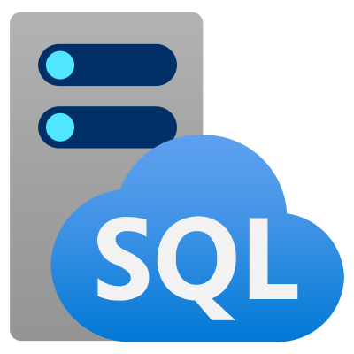




SQL Server 2022 capabilities
Cloud connected
Extending T-SQL
Built-in query intelligence
Data virtualization | Object storage
Security, scalability, availability
SQL Server 2022

Slide 10

Deploying SQL Server 2022
Windows GUI or command line
Supported OS
Same upgrade options as in previous releases
dbcompat 160
older dbcompat supported
Side by side
RHEL, Ubuntu, SLES package managers
Pre-installed container images
SQL Server
Instance
Azure marketplace images for Virtual Machines
Notes:
We will support restore from sql 2005 but oldest dbcompat is 100 (sql 2008) supported

Slide 11
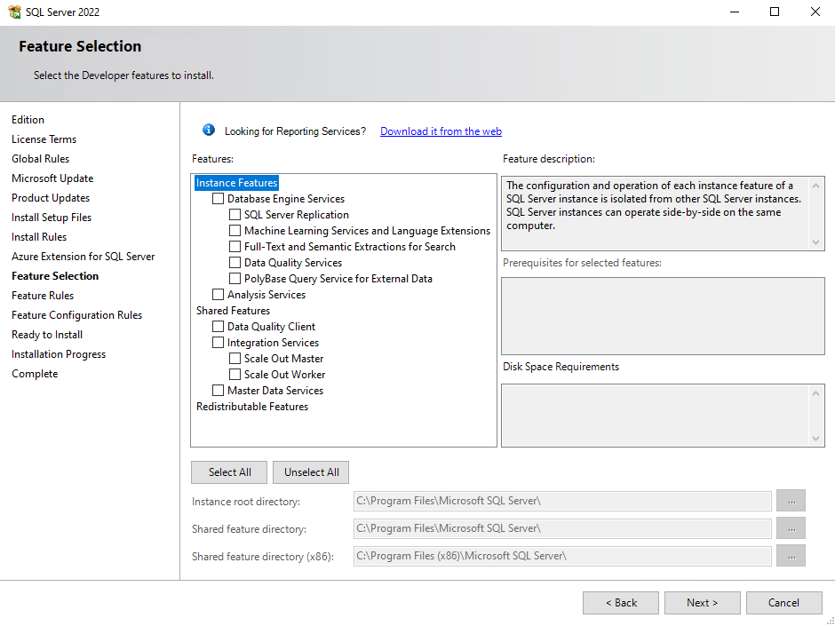
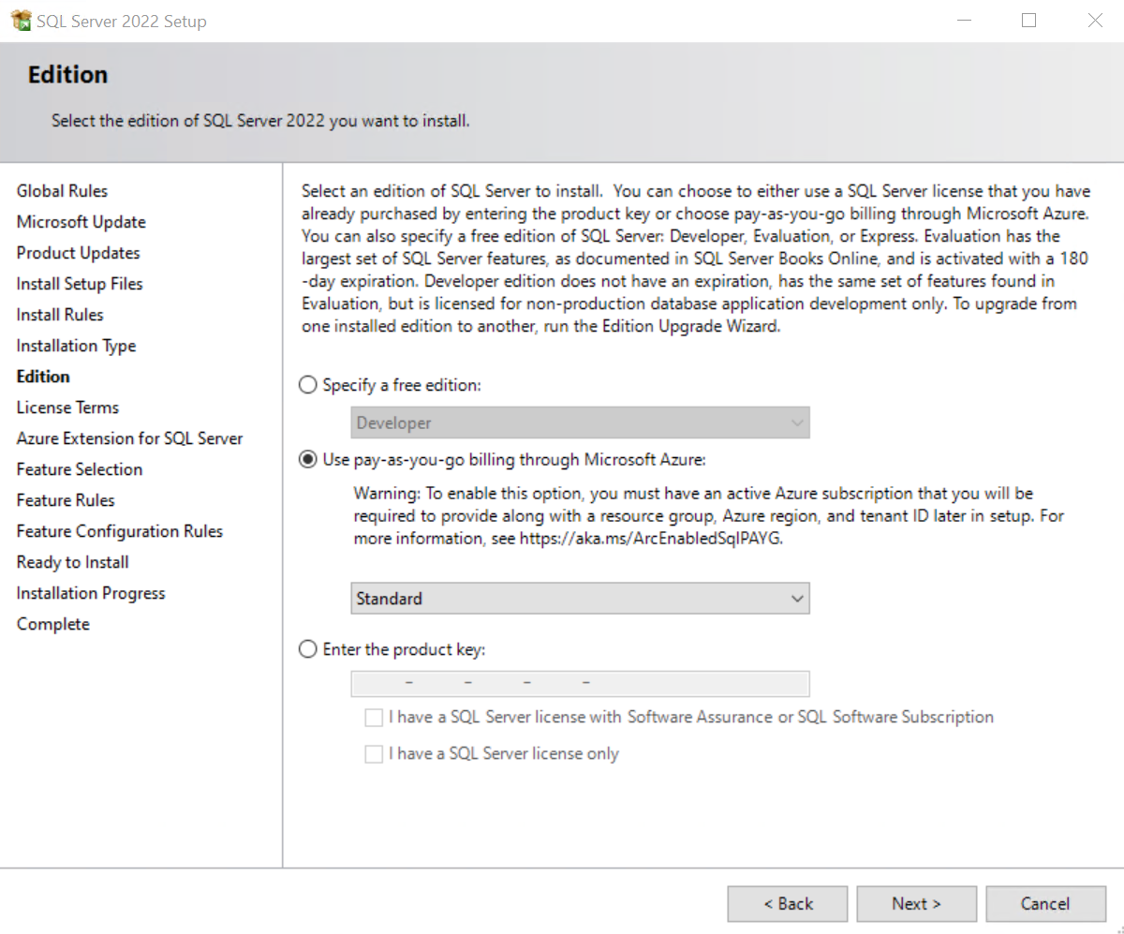
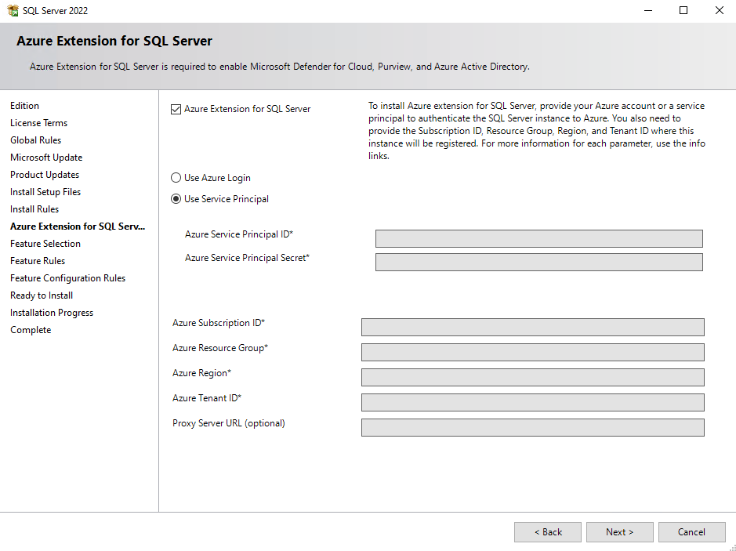
What’s different about SQL Server 2022 setup?
Removed
R, Python, and Java packages¹
Polybase Hadoop connectivity with Java
Polybase scale out groups
Machine learning server
Distributed replay²
Deprecated features
Stretch database
Added
Azure extension for SQL Server
Pay As You go Licensing
¹ Bring your own runtime packages ² Will be available for separate download

Slide 12
Azure extension for SQL Server
Registers Azure Arc-enabled SQL Server
Capabilities for SQL Server 2022
AAD authentication
Microsoft Purview access policies
Microsoft Defender (supported by Monitoring Agent extension)
Inventory, Pay as You Go Licensing, BPA, Automated backups
Extension under the Azure Arc Agent framework
“Mimics” IaaS extension for Azure VM
Uses REST API to communicate with Azure
Supports proxy
Service on Windows and daemon process on Linux
Configure during SQL Server 2022 setup or after with scripts
SQL Server Config Manager to stop or start extension service
Notes:
Here is an article https://docs.microsoft.com/en-us/azure/azure-arc/servers/manage-vm-extensions
Here is another one https://docs.microsoft.com/en-us/azure/azure-arc/servers/agent-overview#agent-component-details
If you supply MS login it auto fills out required fields. You may want to change RG .It even provides a drop down to choose the RG per your sub. It failed though with this cryptic error probably because my login doesn’t have the right permissions.

Slide 13
https://aka.ms/sql2022editions
SQL Server 2022 editions
Azure-enabled with continued performance and security innovation
Enterprise
Mission-critical performance and intelligence for tier 1 databases
Standard
Full featured database with for mid-tier applications and data marts
Feature highlights
Unlimited cores of CPU
Unlimited memory
Azure Synapse Link for SQL (multi-threaded snapshot)
Link feature for Azure SQL Managed Instance
Built-in query intelligence: DOP feedback, CE Feedback, Memory Grant Feedback
Contained Availability Group
AVX 512 extension for batch mode
Express
Free, entry-level database for small web and mobile apps
Feature highlights
Up to 24 cores of CPU
Up to 128 GBs of memory
Azure Synapse Link for SQL
Link feature for Azure SQL Managed Instance (basic availability groups)
Buffer Pool Parallel Scan
Backups to S3-compatible object storage
Feature highlights
Up to 4 cores of CPU
Up to 1410 MBs of memory
Microsoft Purview Policies
Azure AD authentication
Built-in query intelligence: PSP Optimization, Optimized plan forcing
Query store on by default for new databases
Data Lake Virtualization
Ledger
Timeseries support
+ Standard features
+ Express features
+ Express features
Developer
Free to use with all the features of Enterprise Edition specifically for dev/test in non-production environments
Build once and deploy across any SQL Server edition without changing your app

Slide 14
SQL Server 2022 on Linux, Containers, Kubernetes
Linux distributions supported
RHEL 8.0 – 8.5
Ubuntu 20.04
SLELS 15
New DTC transaction management support under WMI
Features not supported that are new to SQL Server 2022
TLS 1.3
Intel QAT backup compression
New MCR container images for SQL Server 2022 (2022-latest)
https://aka.mssqllinux
https://aka.ms/sqlcontainers
https://aka.ms/sqlk8s
Notes:
RHEL container images are listed at https://mcr.microsoft.com/v2/mssql/rhel/server/tags/list
Ubuntu images are listed at https://mcr.microsoft.com/v2/mssql/server/tags/list
There is some new DTC functionality but I’m trying to determine if this is new to SQL22

Slide 15
SQL Server 2022 on Azure Virtual Machine
Marketplace images
Windows and Linux
Dev, Web, Std, and EE Editions
Uses the IaaS Agent Extension
T-SQL snapshot backups supported with Azure disk snapshots
Several VM sizes support AVX vector including AVX512
Portal experience always being updated
SQL Server 2022 features
AAD authentication
Microsoft Purview policies*
https://aka.ms/sqlazurevm
* Planned

Slide 16
Knowledge check
Which of these is one of the major categories for SQL Server 2022 features?
The Azure extension for SQL Server provides
which of these capabilities?
​Cloud connected
​Azure Arc
​Contained Availability Groups
​Built-in query intelligence
​A and D
​Synapse Link
​Managed disaster recovery
​AAD authentication
​Data virtualization
​Azure virtual machine
Notes:
Answers
E
And
C

Slide 17
Summary
SQL Server 2022 is Azure-enabled for disaster recovery, analytics, and security
Built-in query intelligence reduces query tuning and gains you performance with no code changes
SQL Server 2022 has new innovations in security, scalability, and availability
Data virtualization and object storage through standard SQL interfaces
Extending the T-SQL language for new developer scenarios

Slide 18
Connect SQL Server 2022 to Azure
Module 2
SQL Server 2022 Hybrid
Managed disaster recovery with Azure SQL Managed Instance*
Near-real time analytics with Synapse link*
Azure Arc-enabled SQL Server*
Azure Security hybrid capabilities*
Knowledge checks and summary
Demos*

Slide 19

Has SQL Server been hybrid?
SQL Server on Azure Virtual Machines
Azure SQL Managed Instance
Azure SQL Database
Azure Storage
Replication
Linked Servers
Always-On
Availability Groups
BACKUP TO URL

Slide 20






SQL Server 2022 Cloud connected
Azure Arc-enabled
SQL Server
Azure
Active Directory
Microsoft
Purview
Azure Synapse
Analytics
Microsoft Defender
for SQL
Azure SQL
Managed Instance
Authentication
Access Policies
Azure Arc Services
Data changes
Assessments
and Alerts
Replicated data
and failover
Inventory, BPA, PAYG billing
Distributed Availability Groups
Self-hosted integration runtime
Azure Arc Agents and Azure extension for SQL Server
SQL Server 2022

Slide 21

Business continuity through Azure SQL Managed Instance Disaster recovery in the cloud with link feature for Azure SQL Managed Instance
Challenge: Difficult to setup and maintain a DR site
Continuously replicate data to the cloud
Use PaaS for managed disaster recovery
Don’t have an AG? We will build one for you with no replica or clustering required
Built-in distributed availability group (DAG)
Offline Disaster Recovery using backup/restore
Online Disaster Recovery in preview
Online failover
Offline failback
Azure
DR in the cloud
SQL Server 2022
Azure SQL Managed Instance
License free
passive DR
https:/aka.ms/milink

Slide 22

SQL Server Distributed Availability Groups (DAG)
Distributed Availability Group (DAG)
Datacenter 1
Datacenter 2
Log changes
Primary
Secondary
Primary
Secondary
Log changes
Log changes forwarded
Replica
Replica
Replica
Replica
read/write
Read
scale
Read
scale
Availability Group 1
Availability Group 2

Slide 23

Link feature for Managed Instance
SQL Server 2016+ → Migration
SQL Server 2022 → DR
Distributed Availability Group (DAG) async
3
Single step with SSMS
using the replicate wizard
Create link
Database seeding
4
Primary
Primary
1
Secondary
BC tier
dbm
endpoint
dbm
endpoint
Optional
secondary
Replica
Azure network
Replica
Log changes
5
6
read only
read/write
read only
2
Availability Group 1
1 db per (AG) link
100 links for target MI
Multiple instances across versions
Availability Group 2
Notes:
Assume a deployed SQL Server 2022 instance with a database and Azure SQL Managed Instance connected with Azure (VPN, Express Route, Azure virtual network, …)
Establish connectivity between SQL Server and Azure SQL Managed Instance using Azure networking and dbm endpoints
Start the replication database process on SQL Server 2022 by creating an AG (you could have an existing AG) on SQL Server 2022 with dbm endpoints secured on each side.
Create the DAG with SQL Server 2022 and Azure SQL Managed Instance.
Create the link between SQL Server and MI which seeds the database to MI
Changes on the primary are sent to the replica database in MI via transaction log blocks
Execute read queries against replicas in MI

Slide 24
Online failover to Azure SQL Managed Instance
Single step with SSMS
using the failover wizard
1
Planned failover
Stop all writes to database
Switch mode for MI from async to sync
Switch DAG to sync
Verify LSNs match
Remove link to MI
Optionally clean up DAG and AG
Forced failover
Remove link to MI
Clean up DAG and AG when SQL Server is available
2
Database on Azure SQL Managed Instance becomes read/write
3
Redirect application to connect to Azure SQL Managed Instance
4
Migrate instance level objects to Azure SQL Managed Instance

Slide 25
SQL Server database version compatibility
Azure SQL
Managed Instance
SQL Server 2019
Version 15.X
database version != dbcompat
Database 'WideWorldImporters' running the upgrade step from version 904 to version 9XX
database version 904
database version 957
The database was backed up on a server running version 16.00.0312. That version is incompatible with this server, which is running version 15.00.2095. Either restore the database on a server that supports the backup,or use a backup that is compatible with this server.
Locked in with
SQL Server 2019 RTM
Doesn’t change for CUs

Slide 26
Offline Disaster Recovery with SQL Server 2022
Azure SQL
Managed Instance
SQL Server 2022
Create new
link to MI
(Optional)
5
1
Stop write
workload
Restore backup
COPY_ONLY backup
database version 957
database version 957
3
2
Final version locked with
SQL Server 2022 RTM
Migrate instance objects
Redirect application
Aligned with
SQL Server 2022
4
Managed Instance still updated with new features that don’t affect db version

Slide 27
Demo
Exercise 2.0
Link feature for Managed Instance

Slide 28




Azure Synapse Link for SQL Server Seamless analytics over on-prem operational data
Challenge: ETL expensive, out of date,
and affects operational workloads
Store2
Break the wall between operational and analytical stores
New change feed capability reduces impact on OLTP workloads
Near real-time latency between SQL Server and Synapse Analytics
Use SQL pools so harness the full power of a scalable warehouse solution
Analyze all your data using both Spark and SQL runtimes in Synapse
Power BI
12
123
Cloud data
IoT data
SaaS data
Azure Synapse Analytics
Azure Machine Learning
Store
Store
ETL
SQL pools
Azure Data Lake Storage
Spark pools
On-premises
https:/aka.ms/synapselinksql
Notes:
Same concept as CosmosDB link but we use SQL pools so this is a warehouse solution with full scalability.

Slide 29






Using Synapse Link for SQL Server
Synapse Workspace
Dedicated SQL Pool
Landing Zone
Self-hosted Integration Runtime
SQL Server 2022 database
Engine enhancements for change feed
Similar for Azure SQL Database
Operational Databases
SQL Server 2022
Azure Synapse Link for SQL
Azure SQL Database
Operational Databases
Azure Synapse Analytics

Slide 30






Azure Synapse Link for SQL Server How it works
Linked Service
for SQL
Self-hosted
Integration runtime
3
Synapse workspace
Control channel
Control Plane
1
Linked
Connection
Synapse link stored
procedures
5
Linked Service
For LZ
7
database
Table
snapshot
4
parquet &
schema
6
Ingestion
Service
2
Log changes
Landing Zone
Change feed queue
SQL dedicated
pools
csv &
manifest
ADLS Gen2
Notes:
Powershell also supported to create the linked services and manage linked connection
Guide to the numbers and animation:
Start with SQL Serer 2022 deployed with a database and an Azure subscription
Create a Synapse workspace
Create a SQL dedicated pool
Create a linked service for SQL Server 2022. Install SHIR to connect to the Synapse control plane
Create an Azure Storage Account called a Landing Zone Create a linked service for the landing zone
Create a linked connection for the linked service for SQL. Choose your tables. Start the connection. SHIR executes stored procedures to SQL Server 2022. Snapshots of tables are captured and submitted to the landing zone in the form of parquet and schema files. The Ingestion service in the control plane takes the landing zone files and creates tables in the SQL pools. Data is also inserted into the pool tables based on the initial snapshot.
Any modifications to tables are recorded in the transaction log. Change feeds within SQL Server harvest log changes and put them in queue. Internal tasks publish changes to the landing zone in the form of CSV and manifest files. The ingestion service takes the landing zone files and send modifications to affected tables in the SQL pools.
Create a Power I report to visualize your data directly on SQL pool tables.
Details of how ADF talks to SHIR can be found at
https://docs.microsoft.com/en-us/azure/data-factory/create-self-hosted-integration-runtime?tabs=data-factory#command-flow-and-data-flow

Slide 31

Demo
Exercise 2.1
Synapse link for SQL

Slide 32





Azure Arc-enabled SQL Server
Pay-as-you-go-licensing
Free inventory of instances and databases
SQL Best Practices Assessment
Azure Arc-enabled
SQL Server
Automated backups
Organize, inventory, and monitor
Governance and Security
Use with your existing SQL servers
SQL on Windows or Linux servers
Automated security updates
Microsoft Defender for SQL
Azure Active Directory*
Microsoft Purview access policies*
* SQL Server 2022 only
Notes:
2 mins

Slide 33

Demo
Exercise 2.2
Azure Arc-enabled SQL Server

Slide 34
Secure your SQL Server 2022 with Azure
Azure Active Directory
Authentication
Microsoft Purview
Microsoft Defender for SQL
Notes:
TODO: how does Arc extension help Defender like it does with AAD and Purview

Slide 35

Azure Active Directory for SQL Server
https://aka.ms/aadsqlserver
Challenge: I need an alternative for authentication than SQL and Windows domains
Azure Active Directory
SQL Server 2022
Azure VM
Secure auth without a domain
Azure RBAC
Multi-factor authentication
Requires Azure extension
Logins or users without logins
Linked Servers supported
Azure extension for SQL Server
1
3
AAD login
2
windows registry
mssql.conf
SQL Server 2022
Notes:
You can configure via portal, powershell, or az cli

Slide 36

Demo
Exercise 2.3
Azure Active Directory (AAD)

Slide 37

Microsoft Purview integration Insights, lineage, and governance over your entire data estate
Challenge: I need central insights and governance across all of SQL
Automatically scan on-prem SQL Server to capture metadata
Classify data using built-in and custom classifiers and Microsoft Information Protection sensitivity labels
Track lineage for usage and dependencies
Set up and control specific access rights to SQL Server with policies
Insights
Policies
Lineage

Slide 38
Microsoft Purview access policies for SQL Server
Publish a policy from Purview
Works only with AAD accounts
No explicit login required
Engine understands policies to grant login and specific permissions
Engine integrates policies with standard logins and permissions
Works across multiple SQL instances
Remove policy removes authentication
Data*
Read
Modify
DevOps
Performance Monitoring
Security Auditing
Futures:
More granular scope
New policies
Self-service access
*Preview
https://aka.ms/purviewsqlaccesspolicies

Slide 39

Microsoft Purview SQL Server Policy Architecture
Microsoft Purview
Azure
Active Directory
2
Data DevOps policies
Azure extension for SQL Server
1
3
AAD login
4
windows registry
mssql.conf
SQL Server 2022
Policy cache
Notes:
TODO: Checking on CLI
Register SQL Server as an Arc-enabled SQL Server and enable AAD authentication. Then enable Microsoft Purview which writes information into the registry or mssql.conf
Register SQL Server in Purview Studio and create Data and/or DevOps policies
SQL Server uses information in the registry to extract policy information from Purview and store this in a policy cache in system table metadata
A login using AAD tries to connect. SQL Server will use AAD auth and look at the policy cache to determine if the AAD account can connect via policies and applies permissions based on the policy.

Slide 40

Demo
Exercises 2.4
Microsoft Purview Access Policies

Slide 41






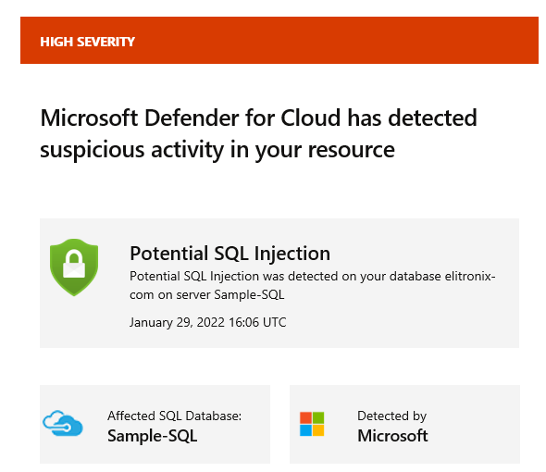
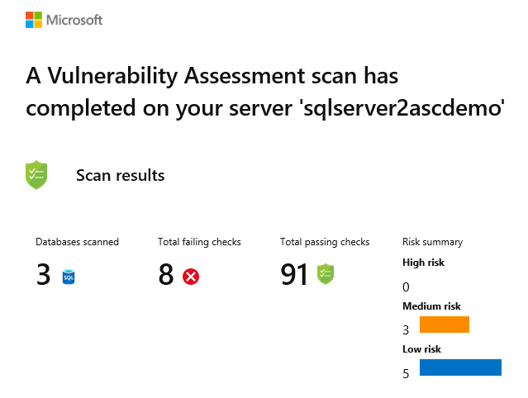

Microsoft Defender for Cloud—Databases Protection Protect SQL workloads through security posture management and allow timely responses to threats
Enable
Detect
SQL security misconfigurations
SQL injection attacks
Brute-force attacks
Unusual data exfiltration
Suspicious access or queries
Remediate
1
2
3
Protected
SQL Workloads
Attacker
Investigate in Azure Sentinel
SecOps
Security
Alert
Vulnerability Assessment
Threat
Remediated
One-click enablement
Sec admin
or DBA
Microsoft Defender
for Cloud
Automatic response
Cloud native security
1-click enablement of protect different type of SQL workloads (IaaS or PaaS)
Security posture management
Discover, track, and remediate SQL workloads security misconfigurations
Advanced threat protection
Detect and response unusual and harmful attempts to breach SQL workloads
Centralized and integrated
Centralize security across all data assets managed by Azure and built-in integration with Sentinel and Purview

Slide 42
Knowledge check
Link for Managed Instance feature is supported on which SQL Server versions?
SQL Server sends changes to Synapse Link
to what location?
​SQL Server 2016
​SQL Server 2019
​SQL Server 2022
​B and C
​A, B, and C
​SQL Pools
​Landing Zone
​Azure Data Factory
​Linked Service
​Linked Connection
Notes:
Answers
E
And
B

Slide 43
Knowledge check
Azure Arc-enabled SQL Server provides what capabilities?
Microsoft Purview policies provide
access to SQL Server by:
​Free inventory of instances and databases
​Managed Database Service
​Synapse Link
​Best Practices Assessment
​A and D
​You create a login and then map the login to a Purview policy
​You create a policy in Purview based on an Azure Active Directory (AAD) account
​You create a role in SQL Server that maps to a Purview policy
​You create a AAD login and add it to a policy role in SQL Server
​Purview scans SQL Server for logins
Notes:
Answers
True
And
B

Slide 44
Summary
Link SQL Server to Azure SQL Managed Instance for managed disaster recovery
Link SQL Server to Synapse for automatic near real-time analytics
Azure Arc-enabled SQL Server provides hybrid capabilities like inventory, PAYG, and BPA
Authenticate SQL Server logins and users with Azure Active Directory (AAD)
Publish policies for data access without creating logins or roles with Microsoft Purview

Slide 45
Accelerate performance with built-in query intelligence
Module 3
Overview
The new Query Store
IQP NextGen foundations
IQP NextGen with dbcompat 140+
IQP NextGen with dbcompat 160
Exercises
Knowledge Checks and Summary

Slide 46

Query Store and Intelligent Query Processing Accelerate query performance and tuning with no code changes
Challenge: Query tuning is expensive and time consuming
Query Store on by default for new databases
Query Store support for read replicas from availability groups*
Query Store hints to shape plans with no code changes
New IQP scenarios enabled through better together capabilities
Intelligent Query Processing (IQP)
Next Generation
Query Store
* Currently requires trace flag 12606

Slide 47
Query Store and Intelligent Query Processing Accelerate query performance and tuning with no code changes
Challenge: Query tuning is expensive and time consuming
Query Store on by default for new databases
Query Store support for read replicas from availability groups*
Query Store hints to shape plans with no code changes
New IQP scenarios enabled through better together capabilities
Intelligent Query Processing (IQP)
Next Generation
Degree of Parallelism (DOP) feedback
Cardinality Estimation (CE) feedback
Parameter Sensitive Plan (PSP) Optimization
Hints
Feedback store
Query Store
* Currently requires trace flag 12606

Slide 48

Intelligent Query Processing (IQP) NextGen
Query Store
Gain consistent performance with no code changes
Upgrade to SQL Server 2022
dbcompat 140+
dbcompat 160
Approximate Percentile
Approximate versions for PERCENTILE_CONT and PERCENTILE_DISC
Memory Grant Feedback Percentiles
Smooth out oscillation with percentile-based calculation
Memory Grant Feedback Persistence
Persist feedback for cache eviction
Parameter Sensitive Plan (PSP)
Optimization
Cache multiple query plans for the same parameterized statement
Save the world from parameter sniffing?
Optimized Plan Forcing
Persist compile steps for forced plans
Reduce compilation overhead
Cardinality Estimation (CE) feedback
Feedback loop for CE model choices and query execution
Auto use query hints
Key principles
“Do no harm”
Options to disable
Degree of Parallelism (DOP) feedback
Feedback loop for DOP for a specific query
Adjust query DOP without recompilation
Adaptive Joins
Interleaved Execution
Memory Grant Feedback
Table Variable Deferred Compilation
Batch Mode on Rowstore
Scalar UDF inlining
Approximate Count Distinct
dbcompat 140 = IQP Gen1
dbcompat 150 = IQP Gen1+2
Optimizer fixes

Slide 49
Query Store enhancements
Query Store on by default for new databases
Query Store support for read replicas from availability groups*
Query Store hints to shape plans with no code changes
Query store is the perfect “store” for IQP
* Currently requires trace flag 12606

Slide 50


Query Store for read replicas*
queries
DBM endpoint
Query Store stats
DBM
endpoint
Primary
replica
Read
replica
Query Store
stats
Query Store
stats
Query Store queries
Query Store queries
* Currently requires trace flag 12606

Slide 51
Intelligent Query Processing (IQP) NextGen
Query Store
Gain consistent performance with no code changes
Upgrade to SQL Server 2022
Approximate Percentile
Approximate versions for PERCENTILE_CONT and PERCENTILE_DISC
Optimized Plan Forcing
Persist compile steps for forced plans
Reduce compilation overhead

Slide 52
Intelligent Query Processing (IQP) NextGen
Query Store
Gain consistent performance with no code changes
Upgrade to SQL Server 2022
dbcompat 140+
Approximate Percentile
Approximate versions for PERCENTILE_CONT and PERCENTILE_DISC
Memory Grant Feedback Percentiles
Smooth out oscillation with percentile-based calculation
Memory Grant Feedback Persistence
Persist feedback for cache eviction
Optimized Plan Forcing
Persist compile steps for forced plans
Reduce compilation overhead

Slide 53
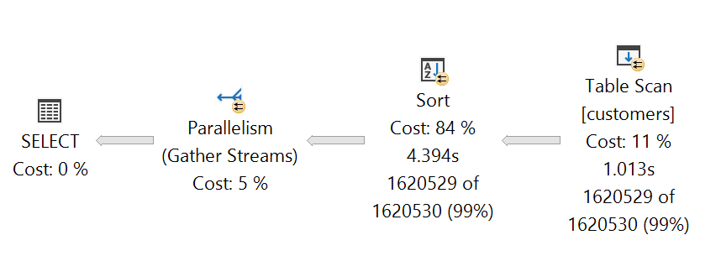
What is a memory grant?
SELECT customer_id, customer_type, customer_date
FROM customers
WHERE customer_date < GETDATE()
ORDER BY customer_date, customer_type
1,000,000, rows x
500 bytes per row
= ~500MB
Memory Grant
Granted before execution
Allocation during execution

Slide 54



When can memory grants become a problem?
1,000,000, rows x
500 bytes per row
= ~500MB
Memory Grant
Granted before execution
RESOURCE_SEMAPHORE
Memory Grant
1MB
Actual Memory Needed
500MB
tempdb
IO_COMPLETION

Slide 55
What is Memory Grant Feedback (MGF)?
Memory allocated at start of query execution for operators like hashes and sorts
Estimates could cause memory grant to be wrong
Too small = tempdb spill
Too big = RESOURCE_SEMAPHORE waits
Workarounds include hints and resource governor
Memory Grant
SQL Server 2017 and 2019
First batch mode only and then row store
Observe actual grant after execution
Adjust next execution if grant was incorrect

Slide 56
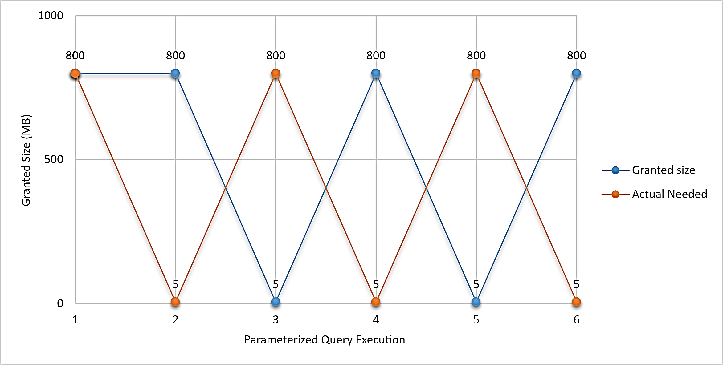
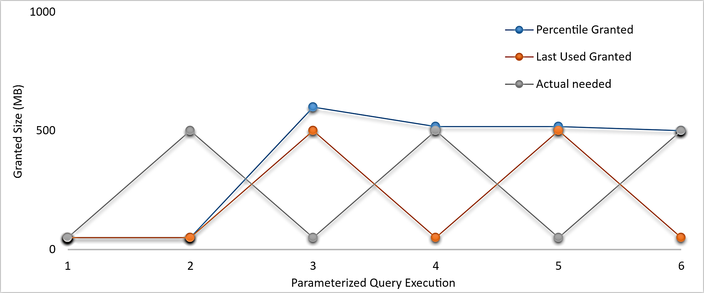
MGF Percentiles and Persistence
MGF Percentiles
Solves problem if memory grant feedback is constantly moving the grant back and forth
We would disable before with volatility
Now use a trend over time (favor avoiding spills)
MGF Persistence
Store feedback in the Query Store to survive plan cache eviction and restarts

Slide 57
Intelligent Query Processing (IQP) NextGen
Query Store
Gain consistent performance with no code changes
Upgrade to SQL Server 2022
dbcompat 140+
dbcompat 160
Approximate Percentile
Approximate versions for PERCENTILE_CONT and PERCENTILE_DISC
Memory Grant Feedback Percentiles
Smooth out oscillation with percentile-based calculation
Memory Grant Feedback Persistence
Persist feedback for cache eviction
Parameter Sensitive Plan (PSP)
Optimization
Cache multiple query plans for the same parameterized statement
Save the world from parameter sniffing?
Optimized Plan Forcing
Persist compile steps for forced plans
Reduce compilation overhead
Cardinality Estimation (CE) feedback
Feedback loop for CE model choices and query execution
Auto use query hints
Degree of Parallelism (DOP) feedback
Feedback loop for DOP for a specific query
Adjust query DOP without recompilation

Slide 58
Parameter Sensitive Plan Optimization
Before
With PSP optimization
exec myproc 1
exec myproc 1
Scan
Seek
Scan
Seek
Scan
exec myproc 10
exec myproc 10

Slide 59
How does PSP optimization work?
Parameterized query
Dispatcher plan
Query variant ‘Agents with < 10k listings’
Query variant ‘Agents with > 10k to < 1M listings’
Query variant ‘Agents with >= 1M listings’
Cached plan: seek + lookup + small memory grant
Cached plan: scan + medium memory grant
Cached plan: scan + large memory grant
Not one plan per user
Dispatcher plan and variant plans
We have buckets to represent ranges of rows matching parameter values
Dependent on correct statistics
Variants have different query text but same query hash

Slide 60
Is Parameter Sniffing gone?
Only = operator supported
Finite limit of variants
Conservative ratio for min/max cardinality
You could get a plan not optimal for all parameter values within a variant
Multiple parameters are supported
New Query Store DMVs required to examine stored procs
Issues using DMVs for plan cache
Won’t use if you use conflicting hints, … (psp_skipped_reason_enum)

Slide 61
The problem of the Cardinality Estimation (CE) model
What cardinality to use for query optimization is not always easy and obvious
CE Versions
Legacy CE Model < dbcompat 120
New CE Model >= dbcompat 120
Why the change?
Assumptions from the original model we thought no longer correct and matched modern workloads
Uh…this didn’t quite work out like we thought
Customers upgraded to SQL Server 2014 and used dbcompat 120 and…problems.
Workarounds
Don’t change dbcompat (ouch)
Trace flags
ALTER DATABASE SCOPED CONFIGURATION SET LEGACY_CARDINALITY_ESTIMATION
Query hints

Slide 62
An example CE model problem
SELECT AddressLine1, City, PostalCode FROM Person.Address
WHERE StateProvinceID = 79
AND City = 'Redmond';
Is there a correlation between Redmond and StateProvinceID 79?
1
Full independence
2
3
Partial correlation
Full correlation
Legacy model
Hint or TF
New model
Hint or TF
Either with a hint or TF

Slide 63
Cardinality Estimation (CE) Feedback
Analyze = Optimizer looks for repetitive query execution that match CE patterns with incorrect assumptions
Apply a query store hint
Validate = Check performance has improved
Persist query hint in the query store
Query store hint takes over on subsequent executions
We don’t enable if you have forced a plan, use conflicting hints, or are using the legacy model
We follow the rules of Query Store hints so over time evaluate for best plan

Slide 64
The pain of MAXDOP
Setting MAXDOP just right is a pain
More DOP = More threads = More CPU
Is parallelism bad?
Less DOP = Less threads = Less CPU
Parallel efficiency
The lowest DOP to achieve the same query duration

Slide 65

DOP feedback architecture
SQL query
Query Store background task
query stats
Eligible?
Query Processor
Provide feedback
DOP feedback
Validate
DOP
feedback
Stable, revert, min
Query Store

Slide 66
DOP feedback details
Eligible queries must have a longer duration and repetitive
It’s all about lowering overall CPU usage of the query
Less CPU for DOP query = more CPU for everyone else
Start from MAXDOP precedence setting and lower (never higher)
Factor out common waits = Focus on CPU
Analyze again at recompile

Slide 67


“IQP is a symphony” – Kate Smith
PSPO creates a
variant plan
CE feedback creates a
query store hint
MGF feedback adjusts
the memory grant
DOP feedback
adjusts DOP

Slide 68
Exercises
Exercise 3.1
Parameter Sensitive Plan (PSP) optimization Bonus: Exercise 3.0
Persisted Memory Grant Feedback
Advanced: Exercise 3.2
DOP feedback

Slide 69
Knowledge check
Query Store is now on by default for
SQL Server 2022 under which circumstances:
Parameter Sensitive Plan optimization can help which scenario:
​Create a new database with SSMS in SQL Server 2022
​Use CREATE DATABASE in SQL Server 2022
​Restore a database backup from SQL Server 2019
​A and B
​Restore a version compatible backup from Azure SQL Managed Instance
​Data is skewed and you use ad-hoc queries with your application
​Scenarios where more than one plan in cache would help with stored procedure performance
​Stored procedure performance using parameters in filters with >= operators
​All of the above
Notes:
Answers
D
And
B

Slide 70
Knowledge check
CE Feedback works by:
Parallel efficiency is defined as:
​Applies a query hint in plan cache​
​Disables the legacy cardinality estimation model
​Triggers a recompile to see if the query gets a different plan
​Dynamically change between legacy and new CE model
​Persist a query store hint for queries that improve in performance
​Dynamically calculating the best setting for sp_configure
​The lowest DOP setting for a query to achieve similar duration across executions while lowering CPU
​A MAXDOP setting for the database that lowers the overall CPU for the system
​B and C
Notes:
Answers
E
And
B

Slide 71
Summary
The new Query store is on by default for new databases, provides hints, works with replicas, and is a store for new query intelligence
Upgrade to SQL Server 2022 with any dbcompat and get approx. percentile and optimized plan forcing
Upgrade and use dbcompat 140+ to enable memory grant percentiles and feedback
Upgrade and use dbcompat 160 to light up parameter sensitive plan optimization, ce feedback, and dop feedback
Don’t forget all the great innovations from IQP Gen1 and 2 that come with dbcompat 140 and 150+

Slide 72
Power your database with security, scalability, and availability
Module 4
Overview
Security enhancements
Scalability enhancements
Availability enhancements
Purvi’s List
Exercises
Knowledge Checks and Summary

Slide 73





Industry-proven database engine Security, scalability, and availability
Secure
Scalable
Available
Ledger for SQL Server
Always encrypted enhancements
Strict connected encryption (TDS 8.0)
Buffer pool parallel scan
“Hands-free” tempdb
Auto async update stats concurrency
Contained Availability Groups
Cross-platform SNAPSHOT backups
Intel QuickAssistTM Technology backup compression

Slide 74
Security enhancements
Ledger for SQL Server
Always encrypted enhancements
Strict connected encryption (TDS 8.0 and TLS 1.3)
PFX certificate support
New granular fixed server roles
Enhancements for Dynamic Data Masking
Notes:
Strict connected encryption can be forced on server with Network Config

Slide 75

Ledger for SQL Server Tamper-evidence track record of data over time
Challenge: I want the power of blockchain in a centralized system like SQL Server
Bank Regulator
Bank A
Use a cryptographically hashed ledger detect tampering by malicious actors
Built into SQL Server with T-SQL
Establish digital trust in a centralized system using blockchain technology.
Attest to other parties that data integrity has not been compromised
Automatic digest storage
Ledger view
Append-only ledger table
Updatable ledger table
History table
Block N
Block N-1
Block N-2
Trusted storage
Database ledger

Slide 76
How to use Ledger for SQL Server
Save digest
Make changes
Manual or auto
Create a Ledger table
INSERT, UPDATE/ DELETE (only updateable)
Updateable or Append Only
View ledger history
Verify Ledger

Slide 77
Ledger FAQ
How is this different from a temporal table?
Built-in transaction auditing
Append-only
Database Ledger and digest for tamper evidence
How is this different than SQL Server Audit?
Transaction history and audit built into database
Digest verification
Can I ALTER a ledger table?
You cannot ALTER a table to “turn off” ledger or disable system versioning
You can alter the schema but there are some limitations
Can I drop a ledger table?
Yes, but a history of the dropped table and ledger is kept

Slide 78
Ledger FAQ
How often do I need to save the digest?
As frequent as you need to ensure the ledger is tamper proof
Does Ledger require more space?
Updateable requires similar extra space as temporal
Plus database ledger requires some minimal extra space for hashes and blockchain
Digests small and separate but you may need a long history
You can’t archive or truncate ledger tables and database ledger
Any perf impact?
Append only should see minimal impact
Updateable would have similar impact as temporal
Notes:
Ledger limits
In-memory tables aren't supported.
Sparse column sets aren't supported.
SWITCH IN/OUT partition isn't supported.
Ledger tables can't have full-text indexes.
Ledger tables can't be graph table.
Ledger tables can't be FileTables.
Ledger tables can't have a rowstore non-clustered index when they have a clustered columnstore index.
Change tracking isn't allowed on the history table but is allowed on ledger tables.
Change data capture isn't supported for ledger tables.
Transactional replication isn't supported for ledger tables.

Slide 79
Scalability enhancements
Buffer pool parallel scan
“Hands-free” tempdb
Auto async update stats concurrency
Auto drop statistics
XML compression
Advanced Vector Extension (AVX) 512 extension to improve batchmode operations.
Improved columnstore segmentation
Ordered clustered columnstore index
Notes:
TODO: Review with latest SQL 2022 deck

Slide 80
“Hands-free” tempdb
Tempdb lazy log flush
Tempdb != FUA
1 file = PFS, GAM, SGAM contention
Add multiple files
Trace flags 1117 and 1118
SQL 2016 setup auto adds multiple files
Trace flags not required by SQL Server 2016
PFS concurrency
Autogrow and uniform default for tempdb
Now system table pages become hotspot
Tempdb metadata optimization ON
SGAM and GAM contention remain
SGAM and GAM concurrency
Latch contention gone
Pre SQL Server 2019
SQL Server 2019
SQL Server 2022

Slide 81
Availability enhancements
Contained Availability Groups
Cross-platform SNAPSHOT backups
Intel QuickAssistTM backup compression
ADR enhancements
In-memory OLTP memory enhancements
Shrink database concurrency
Parallel redo enhancements
DAG enhancements
Resumable ADD CONSTRAINT
CREATE INDEX concurrency
Last valid restore time in backupset msdb table
LWW wins auto conflict peer-to-peer replication

Slide 82
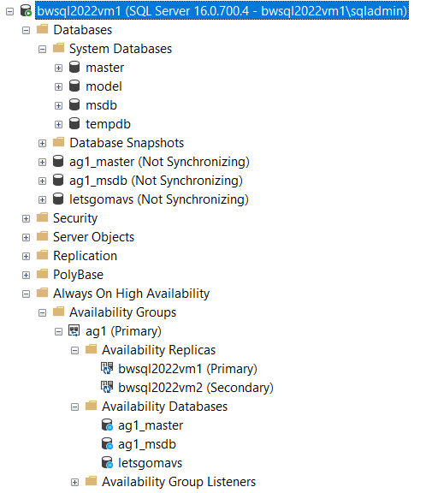
Contained Availability Groups Synchronize instance level objects with data
Challenge: I have to manually synchronize instance level objects with Availability Groups
Create an Availability Group and declare it be CONTAINED
We add a contained master and msdb database to the AG
Connect with listener and contained master and msdb are used
Connect directly and default master and model are used.
SQL Server agent enhanced to understand contained msdb

Slide 83
How Contained AGs work
Primary
Secondary
master
msdb
master
msdb
Listener
or direct db context
MyAG
MyAG
<db>
<db>
MyAG_master
Log changes
MyAG_master
MyAG_msdb
MyAG_msdb

Slide 84

Demo
Exercise 4.2
Contained Availability Groups

Slide 85
Cross-Platform Snapshot Backups
https://aka.ms/sql2022mechanicsupdate
Before
VDI Program
VSS and SQL Writer
Now
T-SQL suspend I/O
Perform your snapshot
T-SQL resume I/O
Why? Backup TB in seconds or milliseconds? Constant performance regardless of size
Why would I halt I/O vs normal BACKUP? ANSWER: Restore faster!
Use storage that supports snapshots—Tip: Azure Storage does by default
Is this a SQL backup? ANSWER: Not a separate backup stream but you can restore it
Works on Windows and Linux
Users most likely see WRITELOG waits on suspend
Tip: Use undocumented and unsupported
trace flag 3661 to test it
Notes:
2 mins
Hyperscale uses snapshot backups with Azure Standard Storage

Slide 86





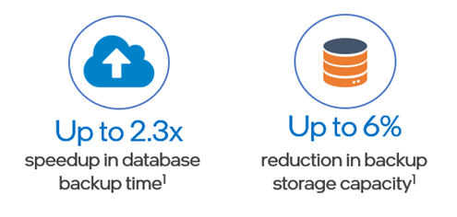
SQL Server 2022—Hardware acceleration & offloading
Current customer demands
Stability for critical workloads
Consistent performance without oversizing
Remove scalability blockers
Make the most of current hardware
Intel QuickAssist Technology (QAT)
Intel QuickAssist Technology (QAT) provides a compression solution that integrates hardware acceleration of compute-intensive workloads on Intel platforms.
Intel QuickAssist Technology (QAT) with SQL Server 2022 off-loads data compression, enabling faster OLTP operations while reducing the impact on the system’s transaction throughput.
Database Backup Improvements for SQL Server 2022 with Intel QuickAssist Technology (QAT):
¹ SOFTWARE BASELINE: Test by Intel as of 10/26/2021. 1-node, 2x Intel® Xeon® Platinum 8358 Processor on Wilson City (ref. platform), 32 cores with 1024 GB (16 slots/ 64GB/ 3200[3200]) total DDR4 memory, ucode 0xD000323, HT on, Turbo on, Windows Server 2019,10.0.17763.1999, [Hyper-V VM], 1x Intel X550, SQL Server 2022 CTP1.1 private test build, 525GB Database, Database Backup with Compression​. WITH INTEL® QUICKASSIST ADAPTER 8970 TECHNOLOGY: Test by Intel as of 10/26/2021. 1-node, 2x Intel® Xeon® Platinum 8358 Processor on Wilson City (ref. platform), 32 cores with 1024 GB (16 slots/ 64GB/ 3200[3200]) total DDR4 memory, ucode 0xD000323, HT on, Turbo on, with Intel® QuickAssist Adapter 8970, 1.70.16.4 driver version, Windows Server 2019,10.0.17763.1999, [Hyper-V VM], 1x Intel X550, SQL Server 2022 CTP1.1 private test build, 525GB Database, Database Backup with Compression​. WITH INTEL® Intelligent Storage Acceleration Library: Test by Intel as of 10/26/2021. 1-node, 2x Intel® Xeon® Platinum 8358 Processor on Wilson City (ref. platform), 32 cores with 1024 GB (16 slots/ 64GB/ 3200[3200]) total DDR4 memory, ucode 0xD000323, HT on, Turbo on, with Intel® Intelligent Storage Acceleration Library v2.30.0.0, Windows Server 2019,10.0.17763.1999, [Hyper-V VM], 1x Intel X550, SQL Server 2022 CTP1.1 private test build, 525GB Database, Database Backup with Compression​. Results may vary.
Notes:
There are several current customer demands that we have captured from customer and support team discussions including MVPs and architects in the field over the years.
Stability for critical workloads – Customers want to reserve capacity for business processes and offload maintenance activities. For orders and operational processes to complete as expected, organizations must make sure they have the performance available for new orders and can continue their business continuity and disaster recovery (BCDR) tasks as well. Some customers find that the size of their databases and the overhead that compression causes, forces them to choose between maintenance activities and revenue. Consider the Black Friday / holiday windows, end of month & end of quarter reporting, and other spikes throughout the year. (Speaker notes: You could mention Mother’s Day & Valentines Day for a florist, tax season, Superbowl advertising, and other critical windows that need special considerations.)
Consistent performance without oversizing – Customers need to minimize CPU spikes. The ability to flatten the resource consumption curve, for higher compute scenarios, provides predictable performance to end users. The goal is for customers to maintain peak workloads while allowing compute to normalize.
Remove scalability blockers – Often customers find that they must over purchase hardware, and this is especially evident with virtual machines, where customers have to scale up the compute in order to handle high CPU tasks such as compression and encryption. Being able to move the high compute workloads away from the host and virtual machines would allow customers to right-size their solutions and maximize their total cost of ownership.
Make the most of current hardware – Customers are interested in taking advantage of their hardware investments and extending the lifecycle of their current platforms.
In SQL Server 2022, we have made investments in the SQL Server engine to provide a method of offloading the types of workloads described previously and in particular, high compute scenarios, to specialized hardware. We have also architected a foundational framework to provide accelerators for SQL Server workloads to extend the SQL Server’s engines ability to handle high compute tasks through offloading.
<CLICK>
The first implementation of this technology is through Microsoft’s partnership with Intel providing a new backup compression option that relies on hardware acceleration. In SQL Server 2022, we will support the Intel Quick Assist Technology (QAT) providing backup compression and hardware acceleration for SQL Server 2022.
Customers will gain better compression with reduced capacity and will also see much improved performance. Better performance means faster backups and even more importantly, faster restores – with faster backups we can reduce our backup windows. And with faster restores we improve recovery SLAs.
There are a number of existing backup compression products already on the market for SQL Server, but these are all software-based which adds overhead, and the backup speeds are unpredictable. Additionally, none of the existing software-based solutions are integrated with the SQL Server engine.
With Intel Quick Assist Technology (QAT) we will provide several commonly used algorithms and formats, such as Gzip, Express, deflate, mszip, and zlib.
The Intel QAT backup compression tightly integrates with SQL Server through T-SQL and customers will be able to choose when they want to use QAT backup compression or when they may want to use the Microsoft default by simply changing the algorithm command in T-SQL.
During testing of Intel Quick Assist Technology (QAT) with SQL Server 2022 - we witnessed over a 2X speed improvement and a 6% reduction in the storage capacity consumed for the tested backups on Icelake processors and even better results on Sapphire Rapid architecture.
With Intel Quick Assist Technology (QAT) and SQL Server 2022 – when customers need to backup their databases with compression, they will not see their backups struggle even when the server is under peak load and will gain better compression rates.

Slide 87
Intel QAT Details
How to use
Install Intel drivers
Hardware or software based
Server configuration option
BACKUP WITH COMPRESSION option
Preview observations
Idle systems don’t benefit from QAT in hardware mode
Hardware mode shines with multiple backup files and heavy CPU workloads
QAT in software mode will usually outperform the default XPRESS

Slide 88
Purvi’s list
Reduce Buffer Pool I/O promotions
Enhanced core spinlock algorithms
Improved Virtual Log File (VLF) algorithms
Instant File Initialization (IFI) behavior for Log file growth even with TDE enabled (does not require special privilege)

Slide 89

Exercises
Exercise 4.0
Ledger for SQL Server Bonus: Exercise 4.1
“Hands-free” tempdb

Slide 90
Knowledge check
Independent verification for Ledger for
SQL Server is done by:
SQL Server 2022 now eliminates what type of bottleneck for tempdb:
​The database ledger through system tables
​The Ledger history view
​Database digests
​Blockchain data in SQL Server tables
​PAGEIOLATCH
​PAGELATCH
​Spinlocks
​A and B
​Row locks on system pages
Notes:
Answers
C
And
B

Slide 91
Knowledge check
A Contained Availability Group replicates
which objects:
What are benefits of using Intel QuickAssist
with SQL Server 2022?
​Linked Servers
​SQL Server Agent jobs
​Logins
​All of the above
​Improved backup compression
​Cross-platform backups on SQL Server for Linux
​Offload CPU resources for SQL query workloads
​A and C
​All of the above
Notes:
Answers
D
And
D

Slide 92
Summary
SQL Server 2022 is an industry proven engine with enhancements in security, scalability, and availability
Ledger for SQL Server provides a tamper evidence record using blockchain technology
Latch page concurrency improvements made management of tempdb “hands-free”
Enhancements in availability include contained AG, cross-platform snapshot backups, and Intel QuickAssist backup compression
There are over 25+ major engine enhancements in SQL Server 2022

Slide 93
Access new sources with data virtualization and object storage
Module 5
Data Virtualization with Polybase
Data Virtualization with SQL Server 2022
Backup and Restore with S3 Object Storage
Exercises
Knowledge Checks and Summary

Slide 94
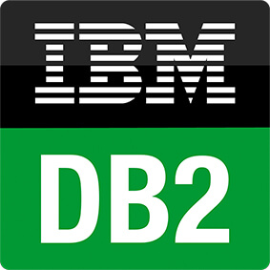







Remove data silos with Polybase—SQL Server 2019
Challenge: Integrating data from numerous data silos is complex with traditional ETL methods
T-SQL
Solution
Access from multiple sources without moving data
Integrate data with data virtualization
T-SQL language with external tables
Distributed/scalable performance with Polybase
…
ODBC
NoSQL
Relational databases
Big Data
Azure SQL Database
Azure Cosmos DB
Excel

Slide 95










Data virtualization and object storage Directly access any data on object storage
Challenge: I need to access data on modern object storage systems through SQL
SQL Engine
OPENROWSET, EXTERNAL TABLE, CETAS
BACKUP/RESTORE
HTTPS REST API
ABS
ADLS
S3 compatible storage
Parquet, Delta, csv, text
SQL backup files

Slide 96



Why S3, parquet, and delta?
S3 created by Amazon but…open protocol
Popular object storage protocol
Inexpensive, durable, unlimited
Parquet is an open-source file format
Schema built-in
Columnar format for efficient compression and retrieval
Delta lake is an open-source storage architecture with delta tables
Parquet files +
Basic transaction log support

Slide 97



Data virtualization in SQL Server 2022
SQL Engine
OPENROWSET, EXTERNAL TABLE, CETAS
HTTPS REST API
adls/abs
S3 compatible storage
Polybase Services
adls
abs
abfs
wasb
Parquet, Delta, csv, text

Slide 98








Using REST API based data virtualization
SQL Engine
Database
master
key
database
scoped
credential
Install
polybase feature
system
tables
external file
format
external
data source
Polybase
instance configuration
User
tables
external
table
We support rowgroup
and column elimination
for Parquet and Delta
Ingest, CETAS, join
OPENROWSET
abs, adls, S3 compatible storage
Parquet, Delta, csv, text
Notes:
CETAS = CREATE EXTERNAL TABLE AS SELECT

Slide 99

Archiving cold data to a lake - CETAS
Partitioned Table
Partition 1
Partition 2
Partition 3
Parquet files
Partition Switch
CREATE EXTERNAL
TABLE AS SELECT (CETAS)
SELECT * FROM
<External Table>
Archive Table
External Table
Notes:
2 mins

Slide 100





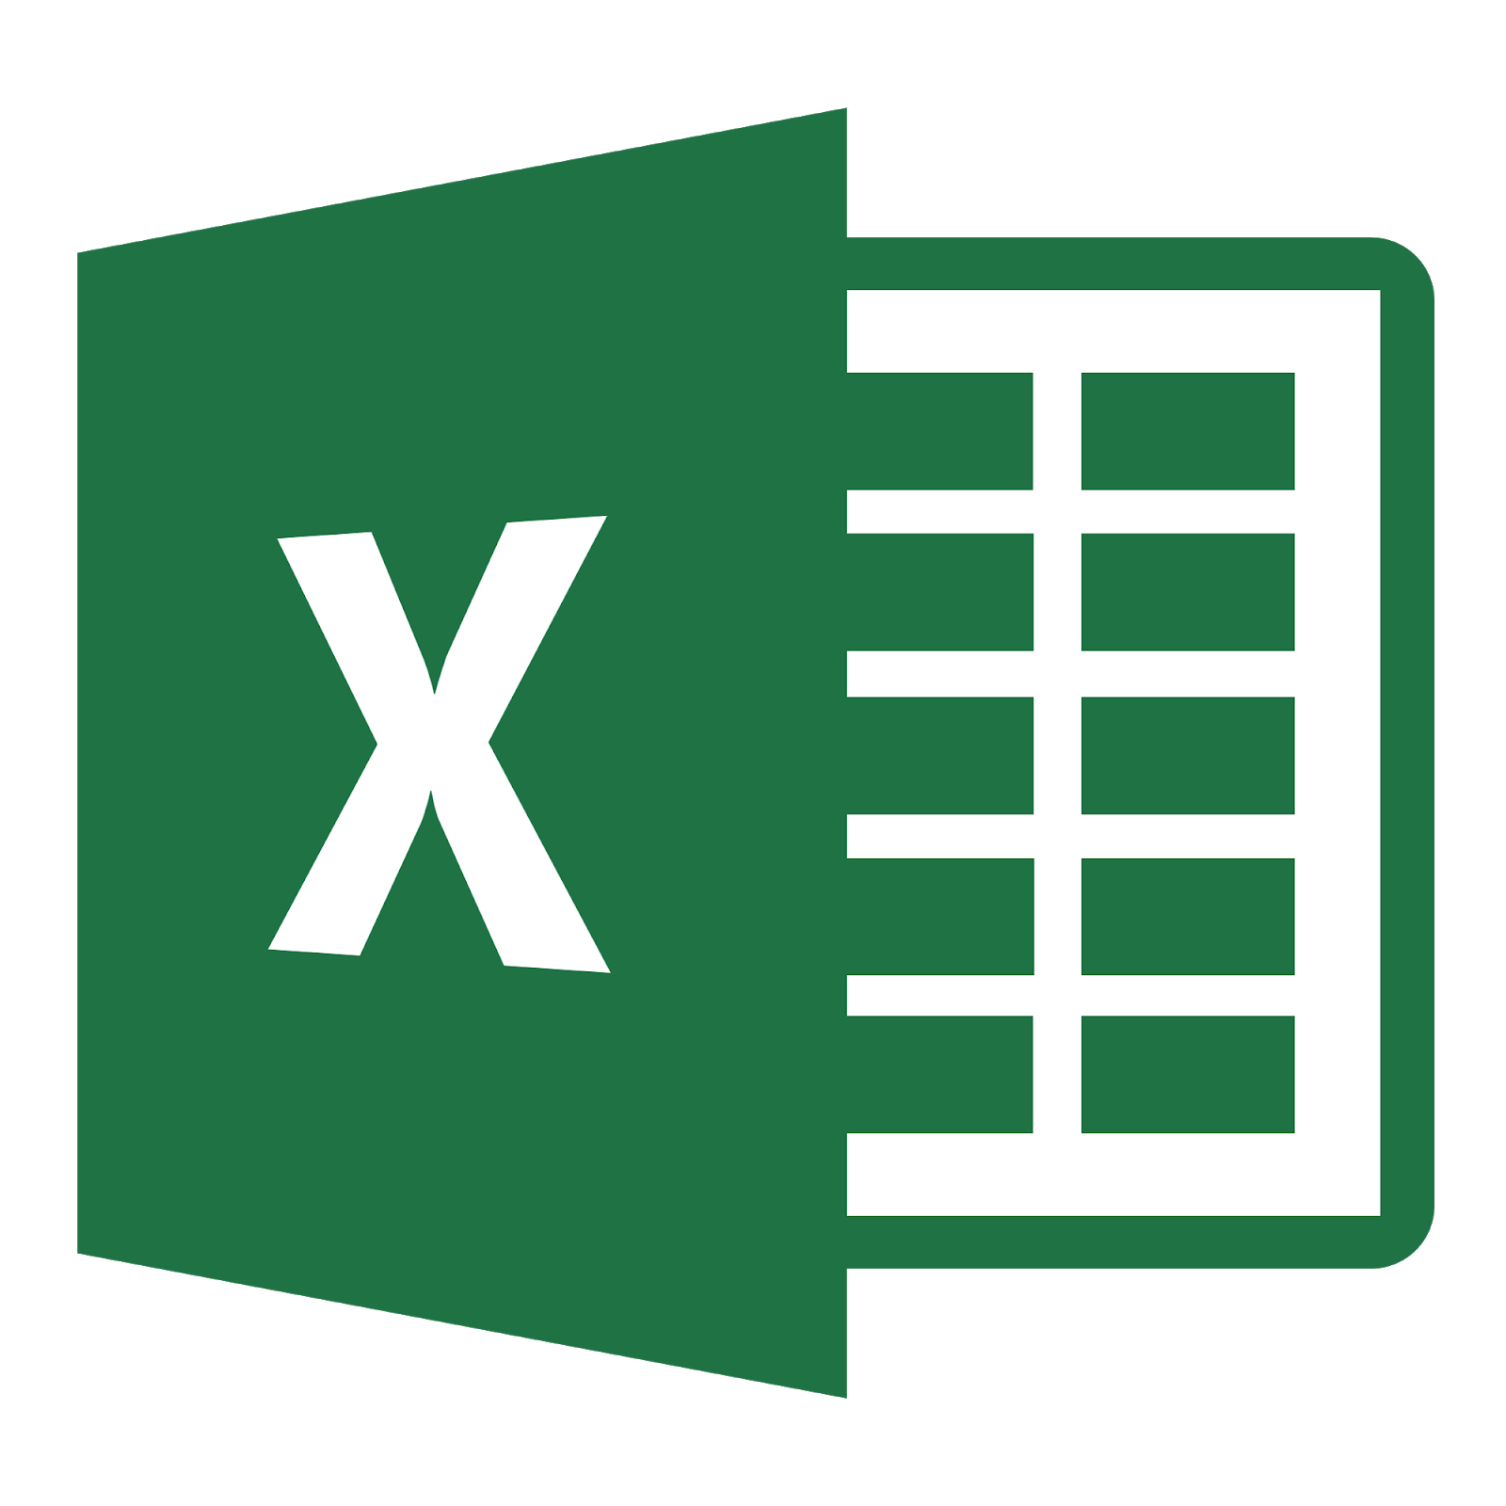
Integrating SQL with Microsoft Fabric
Partitioned Table
Partition 1
Partition 2
Partition 3
Partition Switch
Parquet files
CREATE EXTERNAL
TABLE AS SELECT (CETAS)
SELECT * FROM
<External Table>
Archive Table
External Table
https://aka.ms/sqlfabricdemo
Notes:
2 mins

Slide 101
Using BACKUP/RESTORE with S3 compatible object storage
BACKUP DATABASE <db>
TO URL = ‘s3:<bucket>/<file>’
RESTORE DATABASE <db>
FROM URL = ‘s3:<bucket>/<file>’
REST API
Can I migrate from
AWS RDS to SQL Server 2022?

Slide 102

Exercises
Exercise 5.0
Try out OPENROWSET Exercise 5.1
Notebooks with parquet and S3 Exercise 5.2
Notebooks with delta and S3 Bonus: 5.3
Notebooks with backup/restore and S3 Advanced: 5.4
Using minio server with S3

Slide 103
Knowledge check
SQL Server 2022 can now access external
data sources through:
You can restore a database from AWS RDS
to SQL Server 2022:
​Using REST API to S3 object providers
​Export data to parquet files on REST API data sources from a SELECT
​Access parquet files on ODBC data sources
​A and B
​True
​False
Notes:
Answers
D
And
A

Slide 104
Summary
New REST API data sources include Azure Blob Storage, Azure Data Lake Storage Gen2, and S3 compatible object store providers
SQL Server 2022 now natively recognizes parquet and delta table file formats
SQL Server and backup and restore native backups to and from S3 compatible object store providers

Slide 105
Enhance your application with new T-SQL capabilities
Module 6
Overview
Exercises
Knowledge Checks and Summary

Slide 106

Language enhancements for developers Use your T-SQL skills to do more than ever
Challenge: I want to get new features without learning a new language
ISJSON
JSON_PATH_EXISTS
JSON_OBJECT
JSON_ARRAY
GREATEST
LEAST
STRING_SPLIT
TRIM functions
DATETRUNC
IS [NOT] DISTINCT FROM
WINDOW clause
LEFT_SHIFT
RIGHT_SHIFT
BIT_COUNT
GET_BIT
SET_BIT
DATE_BUCKET
GENERATE_SERIES
FIRST_VALUE
LAST_VALUE

Slide 107

Exercises You pick and choose
Exercise 6.0
JSON functions
Exercise 6.1
Core T-SQL
Exercise 6.2
Time Series
Exercise 6.3
Bit manipulation functions

Slide 108
Knowledge check
Which T-SQL function can produce JSON
formatted data?
Which important enhancement was added to
the STRING_SPLIT function in SQL Server 2022?
​JSON_OBJECT
​JSON_ARRAY
​JSON_TEXT
​A and B
​All of the above
​separator
​multi-value expression
​ordinal
​New string types
Notes:
Answers
D
And
A

Slide 109
Summary
The most enhancements in T-SQL than many previous releases
Enhancements to process JSON
Core engine T-SQL enhancements for ANSI compatibility and industry standards
New T-SQL functions to process time series data

Slide 110
Summary and closing
Module 7
Summary of SQL Server 2022
Resources
Group Discussion and Final Q&A

Slide 111
Summary
SQL Server 2022 is Azure-enabled for disaster recovery, analytics, and security
Built-in query intelligence reduces query tuning and gains you performance with no code changes
SQL Server 2022 has new innovations in security, scalability, and availability
Data virtualization and object storage through standard SQL interfaces
Extending the T-SQL language for new developer scenarios

Slide 112

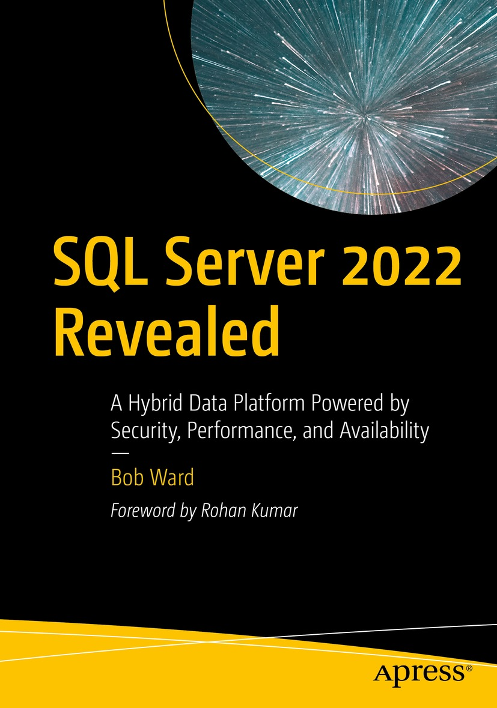

Learn more
Learn more about SQL Server 2022
aka.ms/sqlserver2022
Try our demos
aka.ms/sqlserver2022demos
Download SQL Server 2022
aka.ms/getsqlserver2022
Watch Microsoft Mechanics
aka.ms/sqlserver2022mechanicsupdate
Get our decks
aka.ms/sqlserver2022decks
Don’t miss us on Data Exposed
aka.ms/sqlserver2022series
What’s new for SQL Server 2022
aka.ms/sqlserver2022docs
Read the SQL Server 2022 Blog Series
aka.ms/sqlserver2022blogs
Read the book
aka.ms/sql2022book
Take the Microsoft Learning Path
aka.ms/learnsqlserver2022
Try out the workshop
aka.ms/sql2022workshop

Slide 113
Thank you!
Thank you!

Slide 114





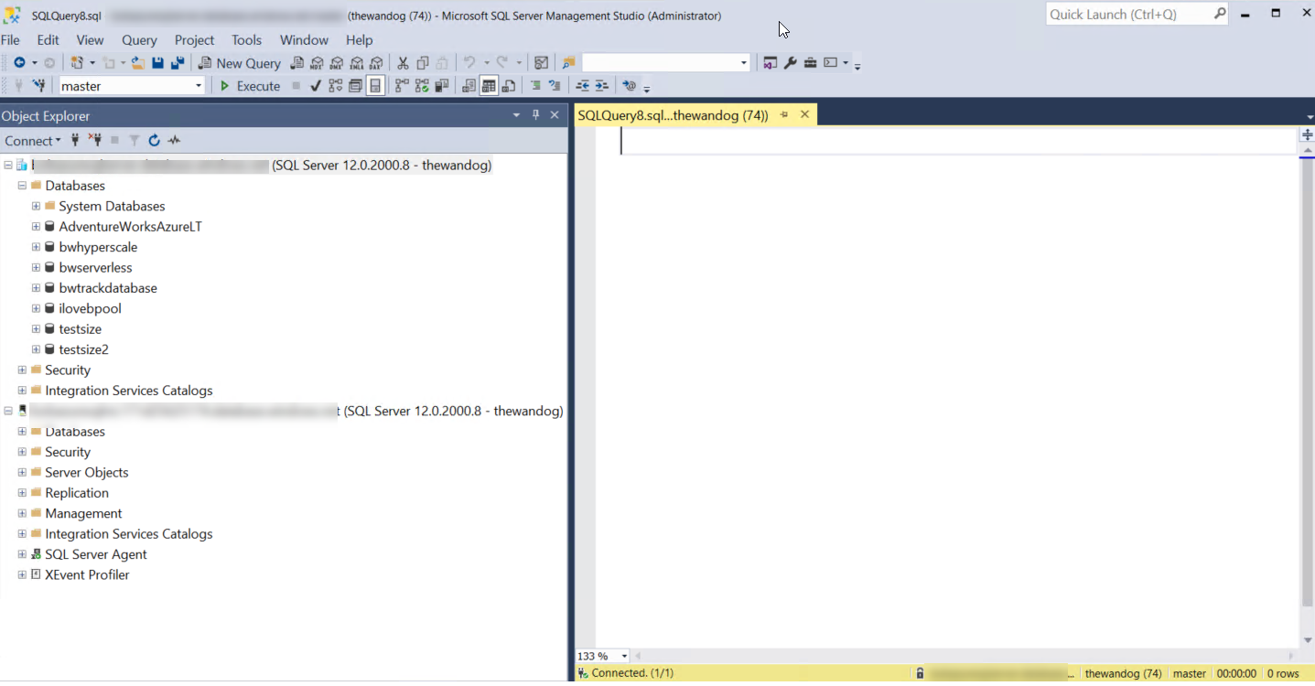
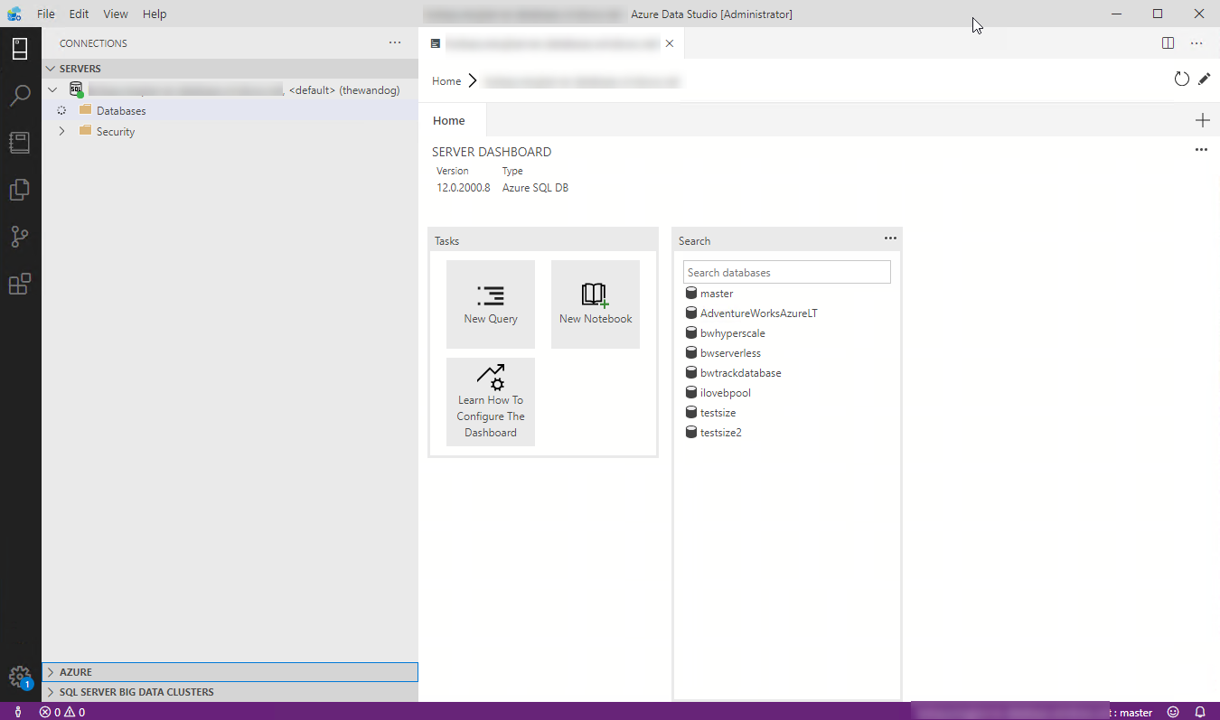




Applications, Tools, and T-SQL
Powershell
sqlcmd
Azure Data Studio
bcp
SQL Server Management Studio (SSMS)
Windows Only
New 19.X version
Tabular Data Stream (TDS) 8.0 and T-SQL

Slide 115
SSRS and SSAS in SQL Server 2022
SSAS
Power BI support for SQL Server 2022 Analysis Services tabular models as a DirectQuery connection for composite models
Improved MDX query performance
Improved resource governance
Query interleaving now includes short query bias with fast cancellation
SSRS
Enhanced Windows Narrator support for the new Windows OS (Operating Systems) and Windows Server
Security enhancements
Browser performance improvements with Angular
Accessibility bug fixes
Support for SQL Server 2022 instances report server catalog
Reliability updates
Notes:
Get details for SSAS at https://powerbi.microsoft.com/en-us/blog/whats-new-in-sql-server-2022-analysis-services-ctp-2-0
Get details for SSRS at https://powerbi.microsoft.com/en-us/blog/reminder-of-features-being-removed-with-the-next-release-of-sql-server/
TODO: Still waiting for Cookie McCray for details on these

Slide 116
What is a hybrid data platform?
A product or service offered both on-premises and the cloud with consistency
A product on-premises connected to the cloud to enhance data capabilities

Slide 117
Notes about Synapse Link
Catalog views, DMVs, and Extended Events for monitoring and debugging
Datatypes not supported include image, text, xml, timestamp, UDT, geometry, geography
Can’t be used with database that use these: temporal, memory optimized, CDC, columnstore, graph
Use scheduled mode to spend less on ingestion
Create separate linked connections for same databases to separate ingestion
Only committed transactions sent to Landing Zone (LZ)
“Think” replication. Transaction commit not affected but log can’t be truncated until committed in LZ
Landing Zone is cleaned up periodically for files no longer needed
aka.ms/synapselinksql

